Slide 1
Tests for symmetric and non-symmetric VTI acoustic wave equation
Gang Yao
2025/8/5

Slide 2
2D Non Symmetric Acoustic Equation
2D Stable Non Symmetric Acoustic Equation
2D Symmetric Acoustic Equation

Slide 3
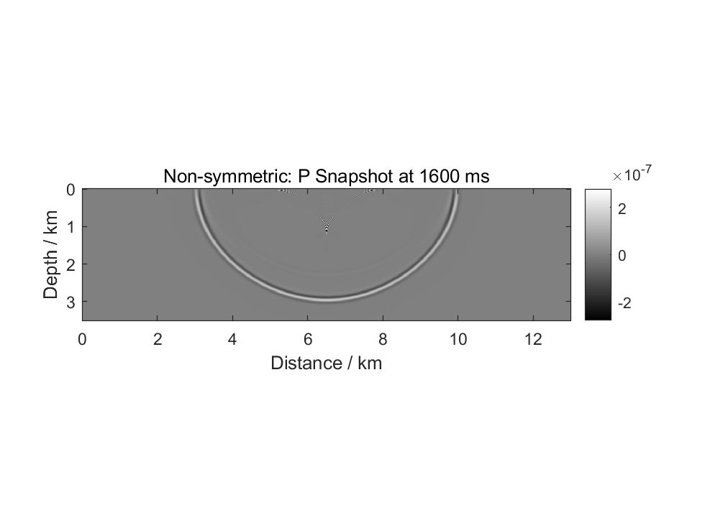

%% constant Model
nz = 351;
nx = 1301;
nt = 1601;
dx = 10;
dz = 10;
dt = 1e-3;
fpeak = 10; % peack frequency of Ricker
src_z = 5; % grid of source depth
src_x = round(nx/2); % grid of source distance
%% Marmousi Model
nz = 351;
nx = 1301;
nt = 2001;
dx = 10;
dz = 10;
dt = 1e-3;
fpeak = 10; % peack frequency of Ricker
src_z = 5; % grid of source depth
src_x = round(nx/2); % grid of source distance

Slide 4
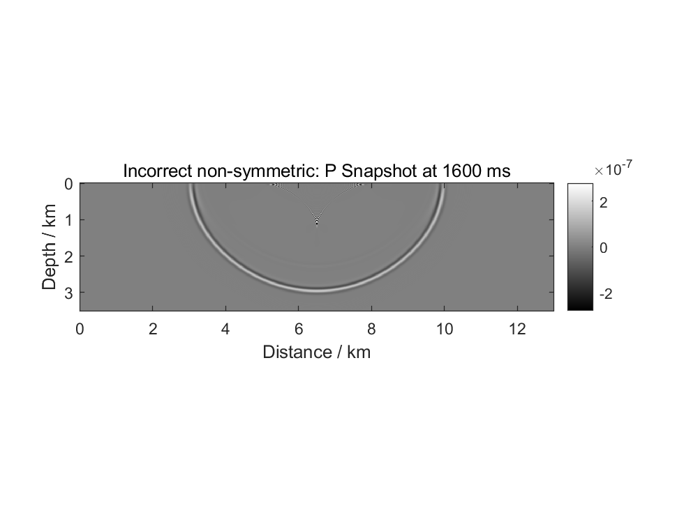

%% constant Model
nz = 351;
nx = 1301;
nt = 1601;
dx = 10;
dz = 10;
dt = 1e-3;
fpeak = 10; % peack frequency of Ricker
src_z = 5; % grid of source depth
src_x = round(nx/2); % grid of source distance
%% Marmousi Model
nz = 351;
nx = 1301;
nt = 2001;
dx = 10;
dz = 10;
dt = 1e-3;
fpeak = 10; % peack frequency of Ricker
src_z = 5; % grid of source depth
src_x = round(nx/2); % grid of source distance

Slide 5
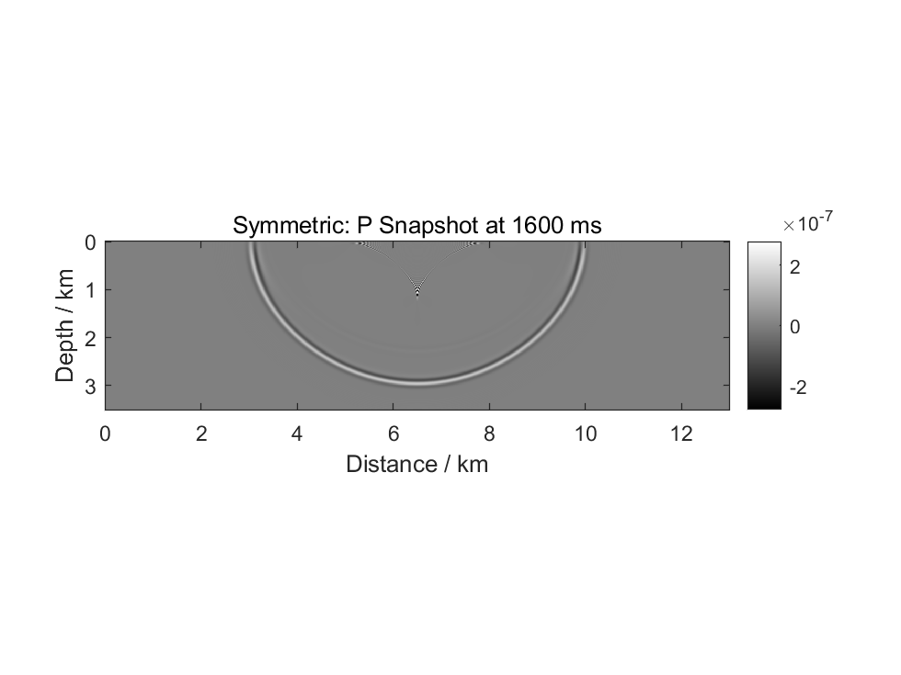

%% constant Model
nz = 351;
nx = 1301;
nt = 1601;
dx = 10;
dz = 10;
dt = 1e-3;
fpeak = 10; % peack frequency of Ricker
src_z = 5; % grid of source depth
src_x = round(nx/2); % grid of source distance
%% Marmousi Model
nz = 351;
nx = 1301;
nt = 2001;
dx = 10;
dz = 10;
dt = 1e-3;
fpeak = 10; % peack frequency of Ricker
src_z = 5; % grid of source depth
src_x = round(nx/2); % grid of source distance

